Slide 1
Data/Data Visualization and Statistics
LECTURE -02
Course Instructor
Engr. Naina Said

Slide 2
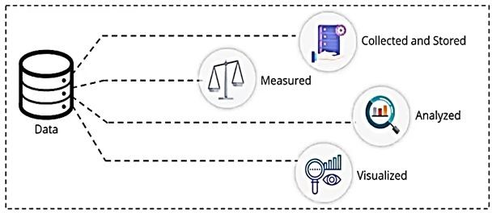
Data
CSE-422: Data Analytics
Data refers to facts collected together for reference or analysis

Slide 3
Cases and Variables
CSE-422: Data Analytics
Case : An experimental unit from which data are collected.
Variable : Characteristic of cases that can take on different values.
Example
A researcher wants to know if dogs who are fed only canned food have different body mass indexes (BMI) than dogs who are fed only hard food. They collect BMI data from 50 dogs who eat only canned food and 50 dogs who eat only hard food
The cases are the dogs. There are two variables: type of food and BMI.

Slide 4
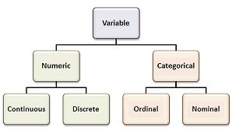
Types of Variables
CSE-422: Data Analytics

Slide 5
Qualitative Variables
CSE-422: Data Analytics
Deals with characteristics that can not be easily measured but can be observed
Nominal Variables
Does not have any inherent ordering or ranking
Ordinal Variables
Data with an ordered series
Example : Customer rating (Good/Average/Bad)
Example : Gender (Male/Female)

Slide 6
Quantitative Variables
CSE-422: Data Analytics
Deals with numbers and things that can be measured objectively.
Discrete Variables Holds finite number of possible values.
Continuous Variables Holds an infinite number of possible values.
Example : Weight of a person
Example : Number of students in a class.

Slide 7
Examples
CSE-422: Data Analytics
Example 1
A team of medical researchers wants to weigh participants in kilograms. What type of variable is weight?
Quantitative/Continuous
Example 2
A teacher conducts a poll in her class. She asks her students if they would prefer chocolate, vanilla, or strawberry ice cream at their class party. What type of variable is preferred ice-cream flavor?
Categorical/Nominal
Example 3
A survey designed for online instructors asks, "How many online courses have you taught?" Three options are given: "none," "some," or "many? What type of variable is this?
Categorical/Ordinal

Slide 8
Explanatory and Response Variables
CSE-422: Data Analytics
Explanatory Variable : Also known as the independent or predictor variable, it explains variations in the response variable.
Response Variable : Also known as the dependent or outcome variable, its value is predicted or its variation is explained by the explanatory variable in an experimental study

Slide 9
Examples
CSE-422: Data Analytics
Example 1
A group of middle school students wants to know if they can use height to predict age. They take a random sample of 50 people at their school, both students and teachers, and record each individual's height and age. What is the explanatory
and response variable?
Explanatory->Height, Response->age
Example 2
A researcher wants to know if fourth graders tend to be taller than third graders? What is the explanatory and response variable in his study?
Explanatory->Grade level, Response->height

Slide 10
We Have Data. So What?
CSE-422: Data Analytics
Raw data is ugly. Does not really tell us much about what is going on.
So how do we draw meaningful/ useful insights from the raw data?
Through Statistics!

Slide 11
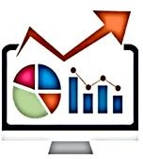
What is Statistics?
CSE-422: Data Analytics
Statistics is an area of applied mathematics which deals with data collection, analysis, interpretation and presentation
The latest sales report has come in and your boss wants you to prepare a report for the management suggesting areas where the company could improve its sales. This is one example that can be solved using statistics.

Slide 12
Data Visualization
CSE-422: Data Analytics

Slide 13
For Categorical Data
CSE-422: Data Analytics
Categorical Data can be visualized using one of the following
Frequency Distribution Tables.
Bar Charts.
Pie Charts.
Pareto Diagrams.
Two Way Tables (for two categorical variables)
Segmented Bar Chart(for two categorical variables)
Clustered Bar Chart(for two categorical variables)

Slide 14
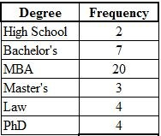
Frequency Distribution Table
CSE-422: Data Analytics
This is a count of the frequency with which each value occurs in the data set.
Ex : Frequency Table of Highest Degree Held by CEOs of 40 Large Corporations

Slide 15
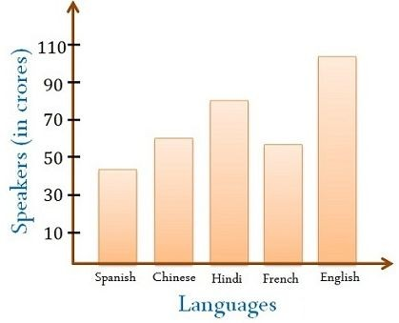
Bar Charts
CSE-422: Data Analytics
A Bar Graph (also called Bar Chart) is a graphical display of data using bars of different heights.

Slide 16
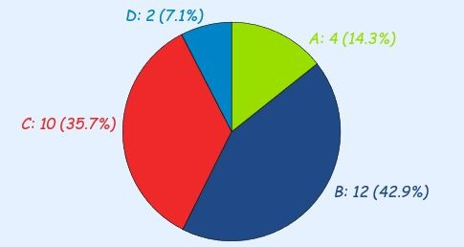
Pie Charts
CSE-422: Data Analytics
A special chart that uses "pie slices" to show relative sizes of data.
Ex : In a recent test, this many students got these grades Grade: A B C D
Students : 4 12 10 2

Slide 17
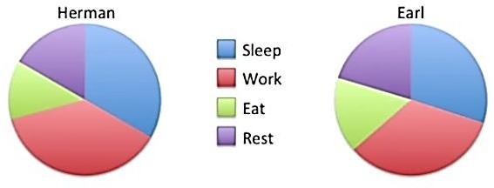
Bar Charts vs Pie Charts
CSE-422: Data Analytics
When to use what is a matter of personal preference.
However, sometimes a bar chart will give you much more insights than the pie chart.
Its hard to visualize here the difference between working time of Herman and Earl.

Slide 18
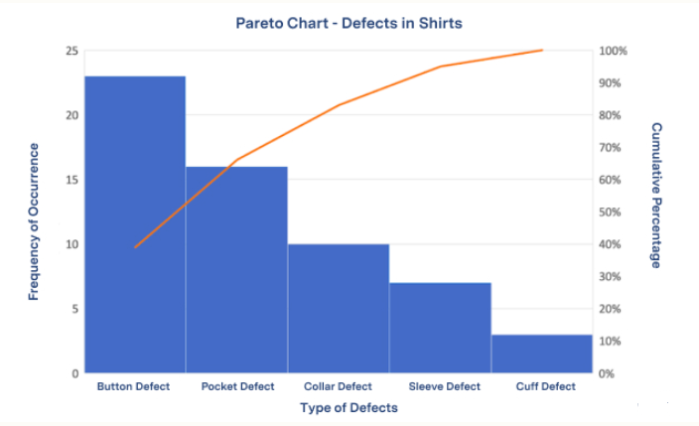
Pareto Charts
CSE-422: Data Analytics
A Pareto Chart is a graph that indicates the frequency of defects, as well as their cumulative impact

Slide 19

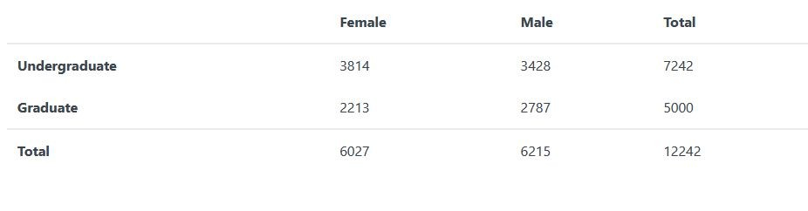
Two Way Table
CSE-422: Data Analytics
A display of counts for two categorical variables in which the rows represent one variable and the columns represent a second

Slide 20
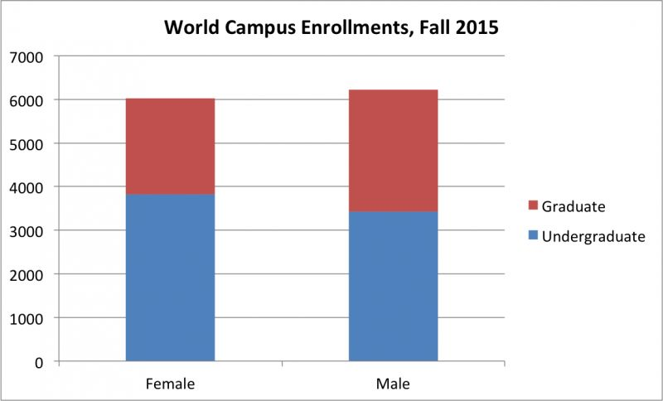
Segmented Bar Chart
CSE-422: Data Analytics
Also known as a stacked bar chart, one categorical variable is represented on the x-axis while the second categorical variable is denoted within the bars

Slide 21
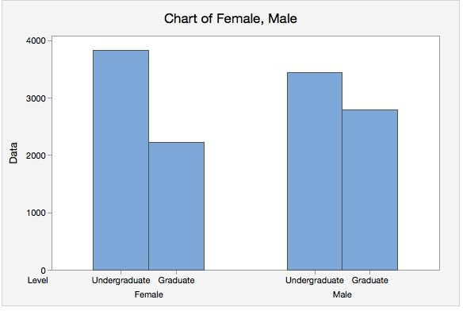
Clustered Bar Chart
CSE-422: Data Analytics
Each bar represents one combination of the two categorical variables.

Slide 22
For Numerical Data
CSE-422: Data Analytics
Numerical Data can be visualized using
Frequency Distribution Tables.
Histograms.
Dot Plots.
Line Graph
Scatter Plots ( For two variables)

Slide 23

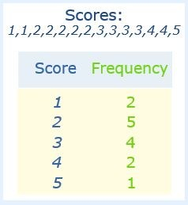
Frequency Distribution Table
CSE-422: Data Analytics
This is a count of the frequency with which each value occurs in the data set.
Ex : Sam's team has scored the following numbers of goals in recent games
2, 3, 1, 2, 1, 3, 2, 3, 4, 5, 4, 2, 2, 3
What interesting insights do you get from this table?
Getting two goals most often
Only once did they get 5 goals

Slide 24

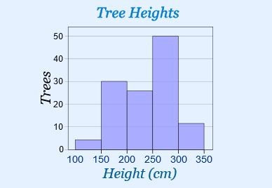
Histogram
CSE-422: Data Analytics
A graphical display of data using bars of different heights.
It is similar to a Bar Chart, but a histogram groups numbers into ranges and is used for quantitative data.
The height of each bar shows how many fall into each range.
These ranges are called “bins”. Bin size is decided by you!

Slide 25
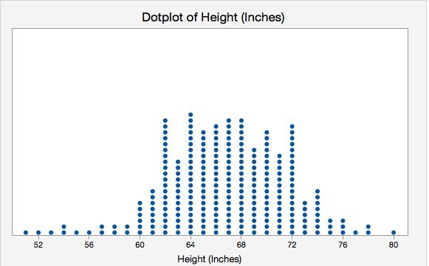
Dot Plots
CSE-422: Data Analytics
Same as histogram, just different representation.

Slide 26
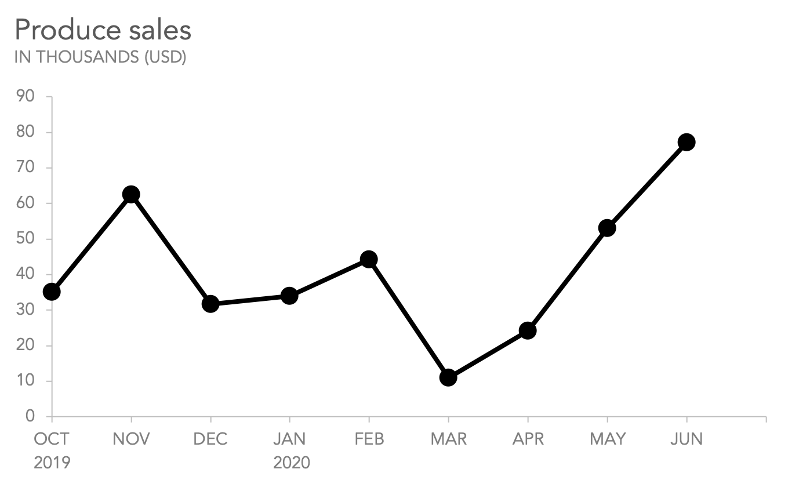
Line Graph
CSE-422: Data Analytics
Tells us about how a quantity changes over time.

Slide 27
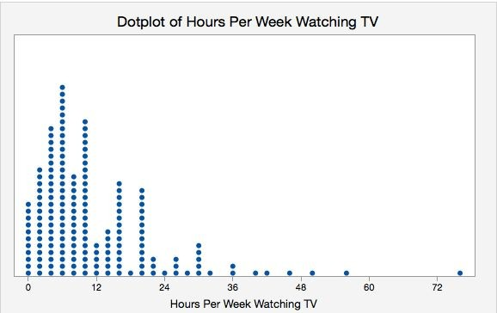
Dot plots a.nd Outliers
CSE-422: Data Analytics
Outliers are the data points that fall outside the general range of other observations.
Outliers are bad, specially for machine learning problems..
Dot plots can help you identify outliers!

Slide 28
Advance Visualization Techniques
CSE-422: Data Analytics
Drill Down
The user can drill down the visualization to display further visualizations at subsequent levels of detail.
Interactive Visualization
The user can see isolated data visualization of his choice in a complex visualization.

Slide 29
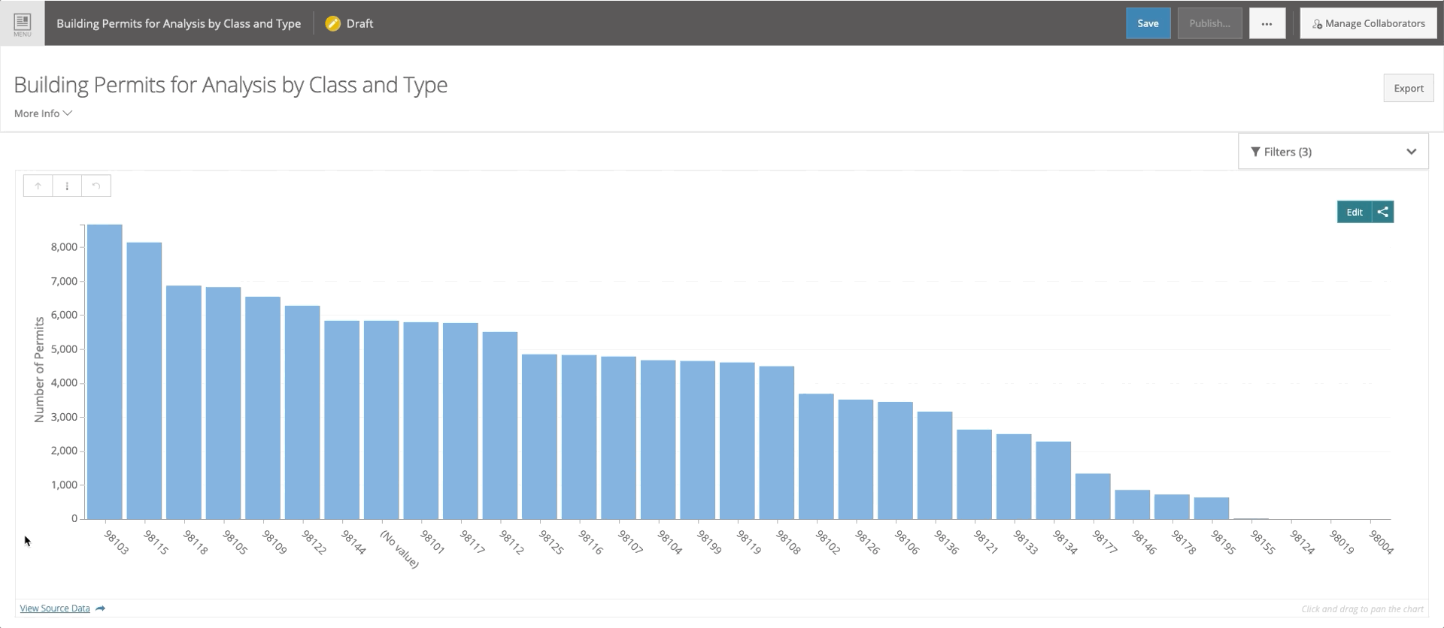
Drill Down
CSE-422: Data Analytics

Slide 30
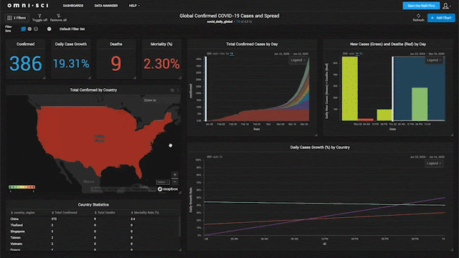
Interactive Visualization
CSE-422: Data Analytics

Slide 31
Assignment
CSE-422: Data Analytics
Read this article
How to Choose the Right Chart and Graph for Your Data
Explore this data visualization catalogue
The Data Visualisation Catalogue
Bonus marks : Can you try to create drill down visualization for some data in any visualization tool of your choice?
Please submit the drill down visualization to google classroom.

Slide 32
Some Terminologies Used in Statistics
CSE-422: Data Analytics

Slide 33
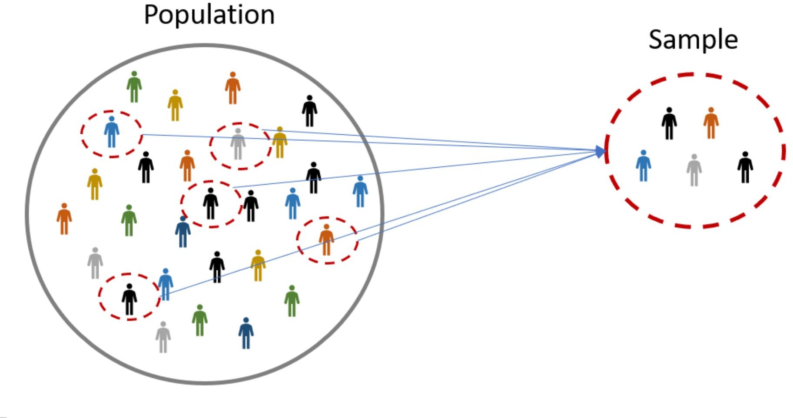
Population vs Sample
CSE-422: Data Analytics
Practically impossible to collect data from the entire population, hence we sample

Slide 34
Population Vs Sample
CSE-422: Data Analytics
Population : The entire set of possible cases
Sample : A subset of the population from which data are collected
Statistic : A measure concerning a sample (e.g., sample mean)
Parameter : A measure concerning a population (e.g., population mean)

Slide 35
Example
CSE-422: Data Analytics
You want to find the average shirt size of your class fellows for an upcoming party. You ask 50 class fellows about their shirt size. What is the population? What is the sample in this case?
Population : Your entire Class
Sample : 50 class mates that you surveyed.

Slide 36
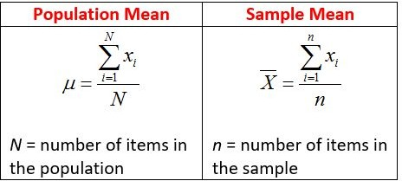
Population and Sample Mean

Slide 37
But What is the Real Use Case?
CSE-422: Data Analytics
When dealing with machine learning problems, your dataset is the sample from the population.
This is why we say, the larger the dataset, the better because as we increase the sample size, we start approaching the population mean which is the true representation of the actual facts.

Slide 38
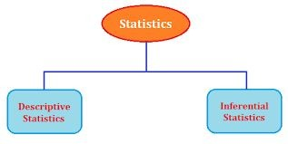
Types of Statistics
CSE-422: Data Analytics

Slide 39
Quiz
CSE-422: Data Analytics
The marketing department for a large retail chain wants to survey their customers about a new advertising plan. They go into one of their largest New York City stores on a Tuesday morning and survey the first 50 people who make a purchase. Do you think there is a sampling bias in this survey? If no, why not? If yes, why?

